Slide 1
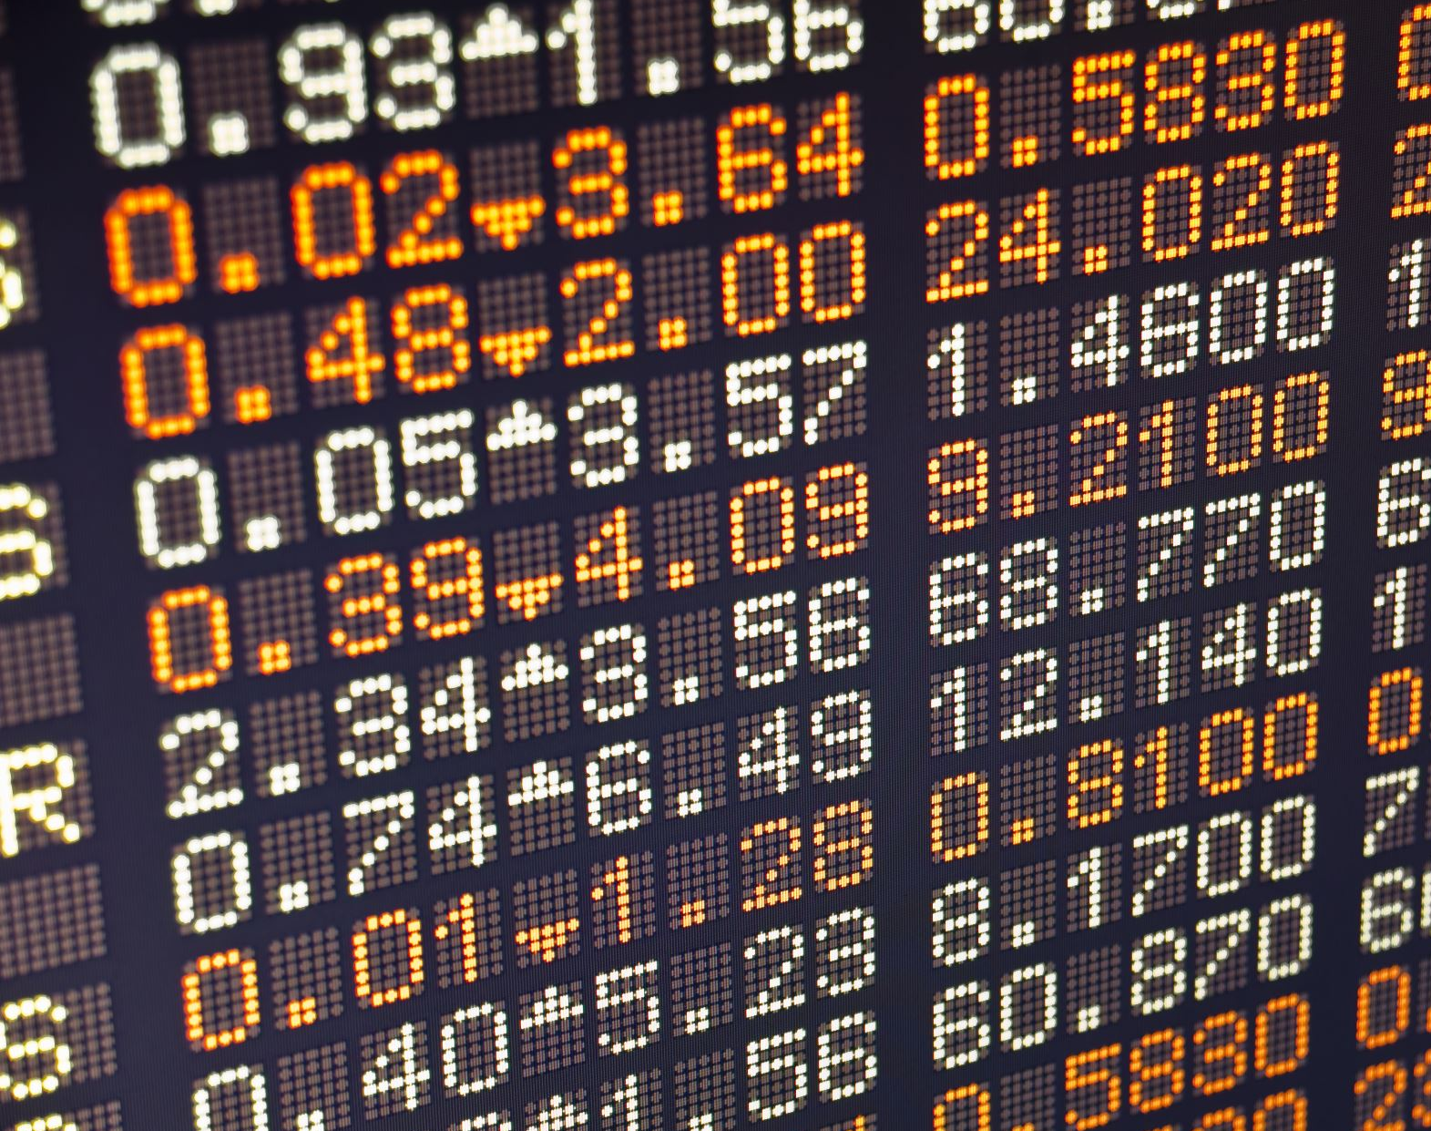
EFFECT OF INFLATION ON STOCK PRICE
CAPSTONE PROJECT

Slide 2
OBJECTIVES
Analyze the correlation between inflation rate and stock price.
To examine the effect of rising inflation rate on the stock price.
To proffer solutions based on this empirical study to the policymakers and market participants.

Slide 3
Research Questions Overview
How does inflation affect the overall performance of the stock market?
01
What historical patterns can be observed in the relationship between inflation rates and stock prices?
02
How can the findings from this empirical study be utilized by policymakers and market participants to develop solutions?
03

Slide 4
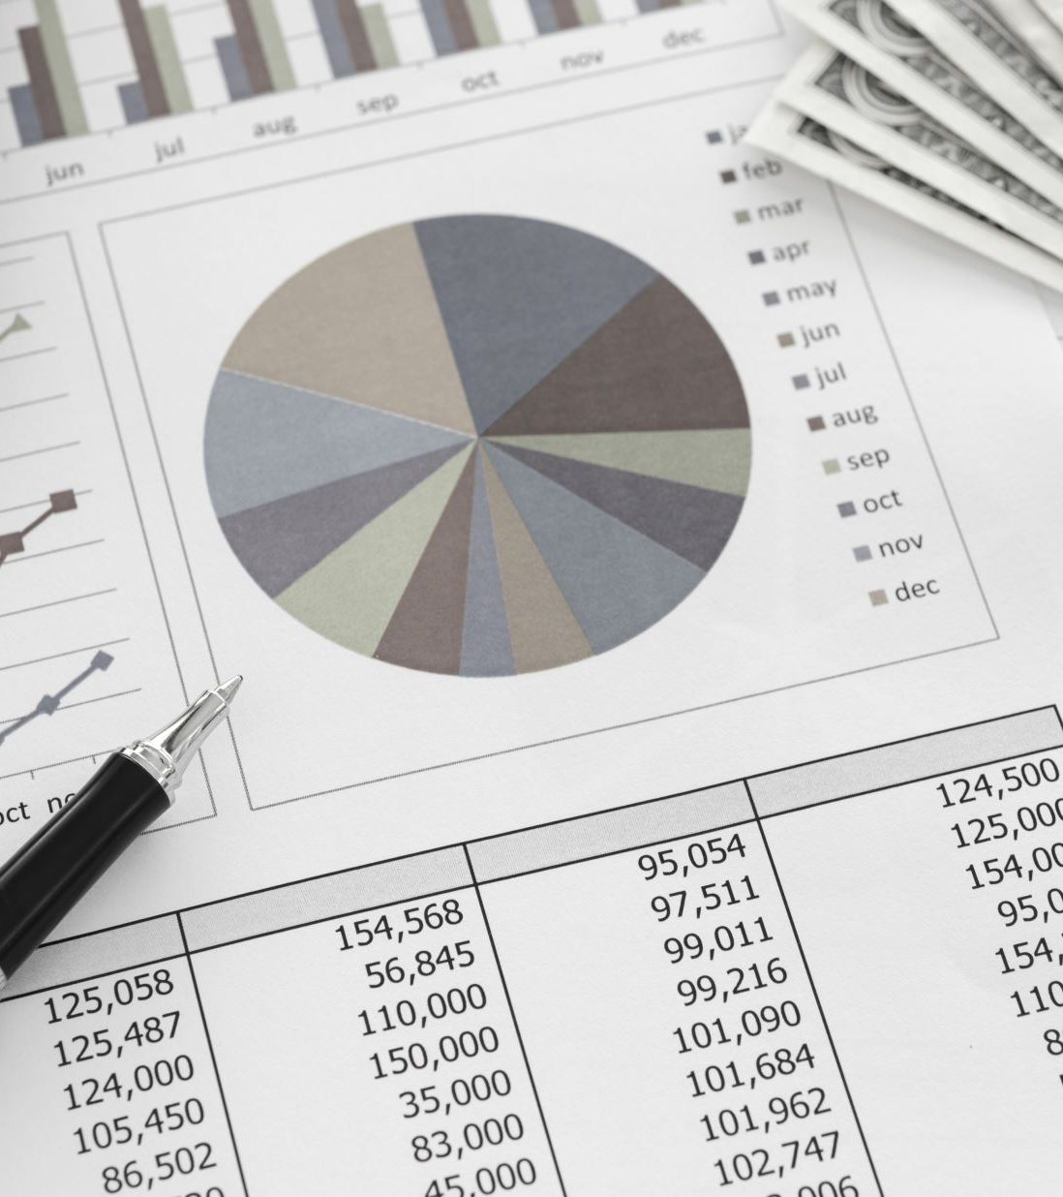
Industry and Challenge
The finance and investment industry is sensitive to inflation, which affects the purchasing power of money and can influence stock market performance negatively by reducing the real value of returns. However, this scenario also presents opportunities for investors to adjust their strategies.

Slide 5
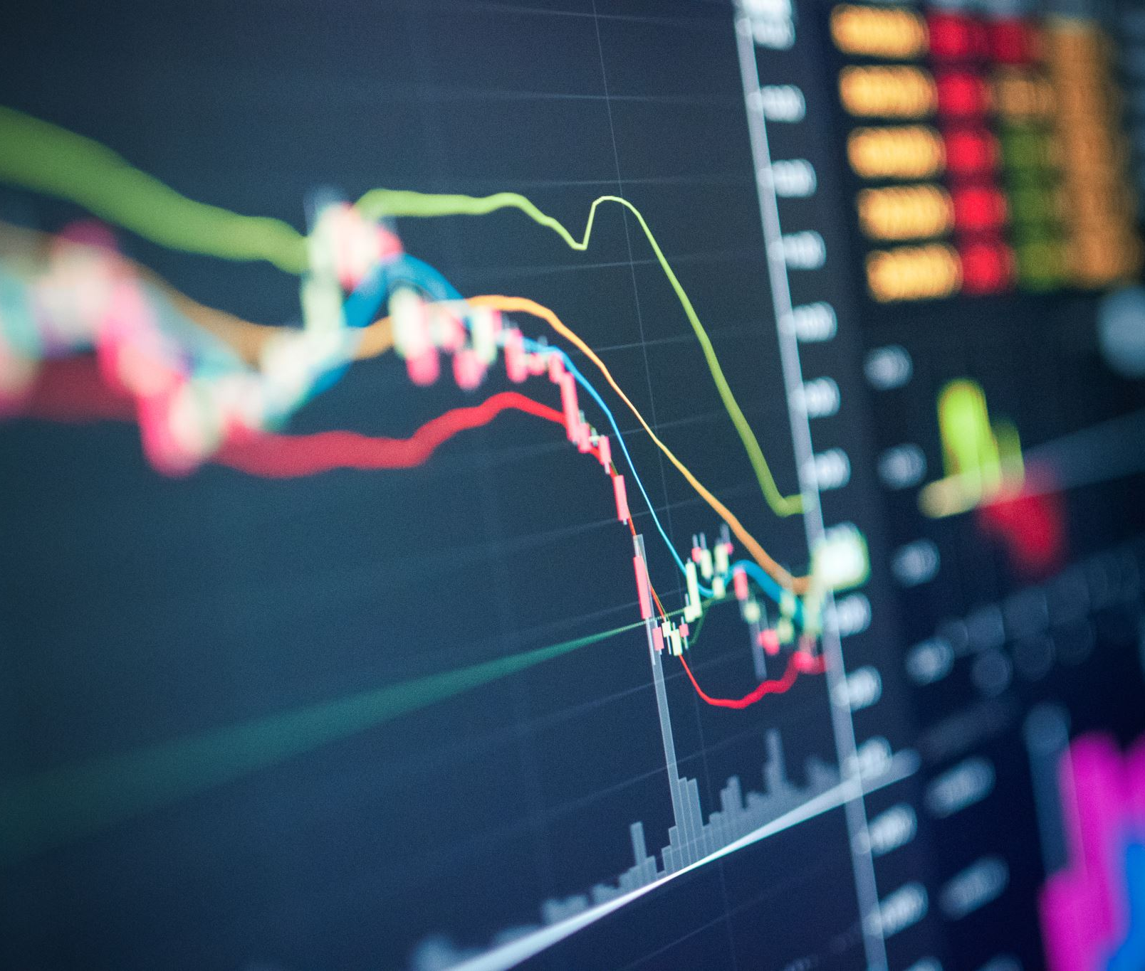
Research Methodology
The major index for the purpose of the study is Canada GSPTSE data from yahoo finance and CPI data from stats can would be collected and used for analysis. These data collected are secondary sources.
For the analysis, linear regression analysis will be carried out to
Analyse the correlation between inflation rate and stock price.
To examine the effect of rising inflation rate on the stock price.
To proffer solutions based on this empirical study to the policymakers and market participants.

Slide 6
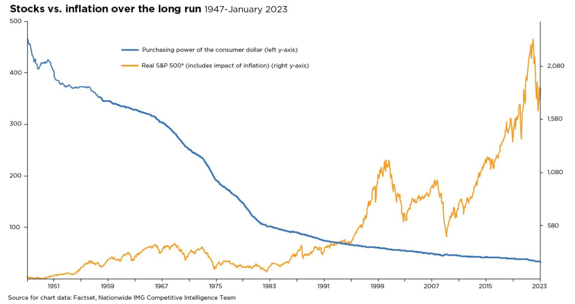
Preliminary Insights or Expected Outcomes
It is anticipated that an uptick in inflation rates may prompt the Central Bank to enact higher interest rates. This potential rise in interest rates is expected to escalate borrowing costs, curtail investment levels, and increase production expenses for businesses, leading to diminished profitability. Consequently, these economic dynamics are likely to suppress economic growth below anticipated levels and reduce the appeal of shares, as diminished corporate profits could result in lower dividend payouts. Additionally, the unpredictability introduced by high inflation may deter companies from engaging in high-risk investments, potentially leading to an economic slowdown. During such uncertain times, investors might favor stability, shifting their capital to perceived safer assets like government bonds, real estate, or gold.

